Slide 1
UNIT 1: INTERPRETATION
1: The Value of Data + Data Narratives
2: Excel Fundamentals
3: Data Referencing
4: Data Aggregation
5: Data Visualization
6: Statistics in Excel*
James Larkin – Data Analytics Instructor
Notes:
* Indicates a FLEX lesson
Excel as a prototyping tool
Finishing Labs

Slide 2
DATA REFERENCING IN EXCEL

Slide 3
LEARNING OBJECTIVES
DATA REFERENCING IN EXCEL
In today’s lesson, we will:
Build relationships between cells in Excel.
Use named ranges to easily reference data subsets.
Manipulate data sets using VLOOKUP and HLOOKUP.
Look up values in other tables using INDEX and MATCH.

Slide 4
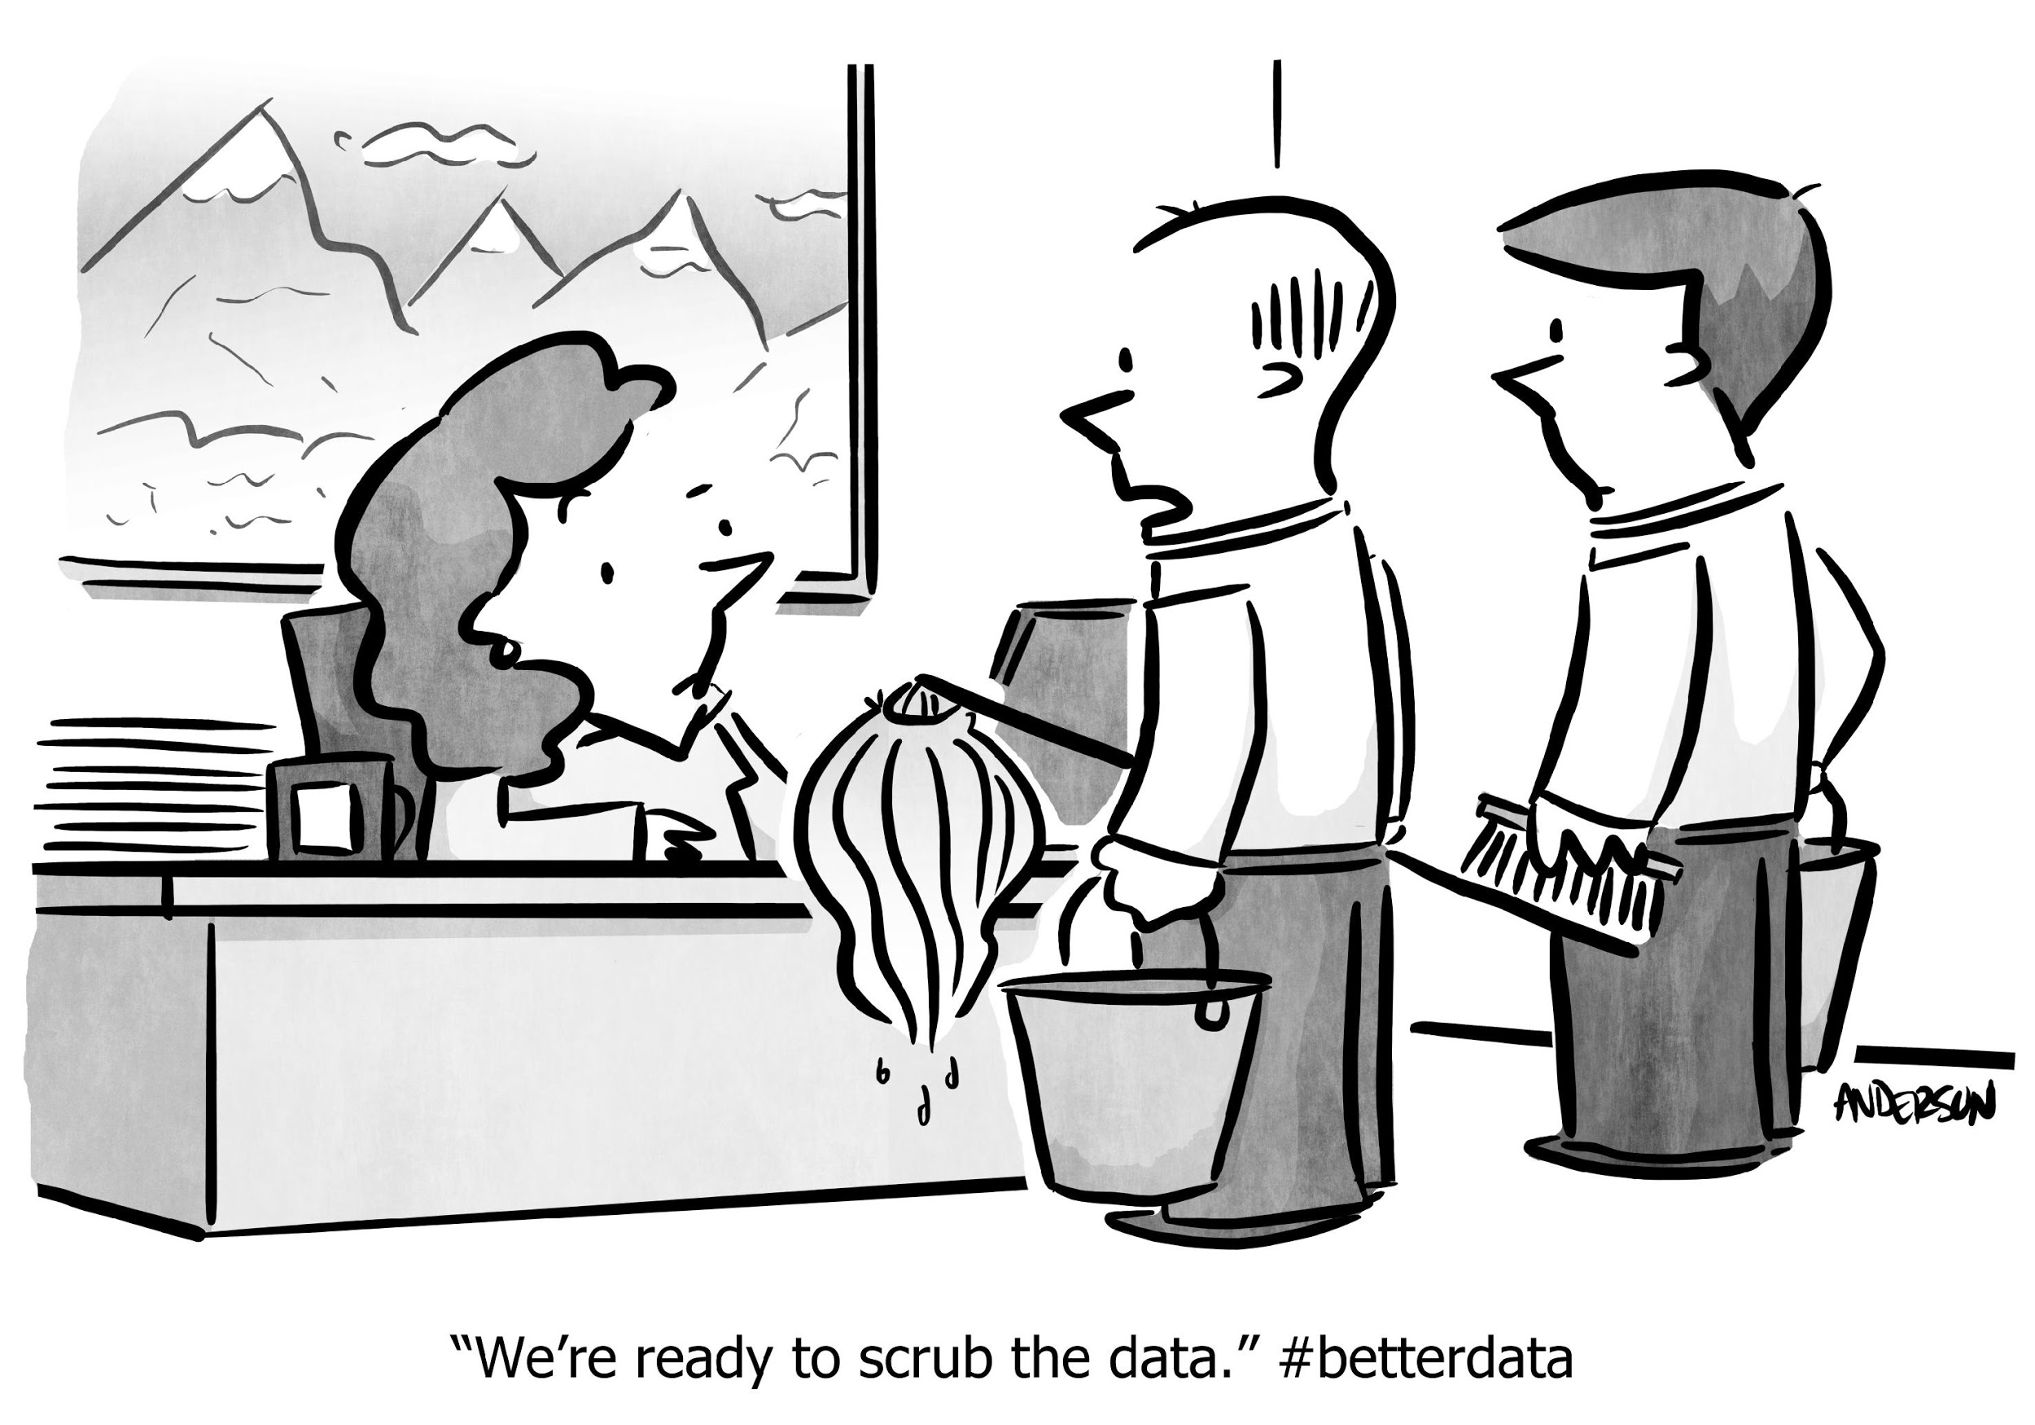
DATA REFERENCING IN EXCEL
RECAP: DATA CLEANING

Slide 5
RECAP: DATA CLEANING - BEST PRACTICES
Keep a copy of all untouched, raw data.
Document your steps through cleaning and preparation:
Create new columns for converted data.
Use color to highlight prepared columns.
Create a summary sheet with “metadata” including:
A directory of other sheets.
An explanation of analysis.
A sample summary of results.

Slide 6
RECAP: DATA CLEANING - FUNCTIONS AND METHODS
Duplicates
Auto filter
Concatenate()
Trim blanks/spaces
Boolean operators
Define a strategy for NULLs.
Clean non-printing charts
Uniform appearance (Upper, Lower, Proper)
Date field selections
Numeric column settings
Text to columns
Aggregation (%, avg, sum)
Substitute

Slide 7
STRATEGIES FOR NULLS
RECAP: DATA CLEANING - MISSING DATA
What are the four primary strategies?
Delete them (with caution).
Ignore them (some have meaning).
Impute values (median or zeros).
Find the value (reference resources).

Slide 8


EXCEL: POWER SHORTCUTS
Notes:
OPTIONAL: The following video contains a short ~2:30min video demonstrating some common Excel power shortcuts. https://www.youtube.com/watch?v=-wZjkihOvSg

Slide 9
DATA REFERENCING IN EXCEL
DATA REFERENCING

Slide 10
DATA REFERENCING
Referencing, in its basic form, means pulling the value of one cell into another cell.
A simple example of this is setting cell A2 to the value of A1 with “=A1.”
Now A2 references A1, and the value of A2 will always be equal to the value of A1.
Absolute Cell Reference ($A$1) (Both Column A and Row 1 is absolute)
Relative Cell Reference (A1)
- The default when entering a cell reference or a range into a formula is relative.
- Relative references change when a formula is copied to another cell.
3. Mixed Cell Reference (A$1) (Column A is relative, Row 1 is now absolute)

Slide 11
DATA REFERENCING
Relative reference example:
When copied across multiple cells, they change based on the relative position of rows and columns. For example, if you copy the formula =A1+B1 from row 1 to row 2, the formula becomes =A2+B2 in row 2, =A3+B3 in row 3, etc.
Absolute reference example:
Unlike relative references, absolute references do not change when copied (or filled). You can use an absolute reference to keep a row and/or column constant. For example, if you copy =$A$1+$B$1 from row 1 to row 2, the formula in row 2 remains =$A$1+$B$1 .

Slide 12
DATA REFERENCING: NAMED RANGE
Naming ranges in Excel is a simple way to identify, define, or refer to a single cell, or group of cells, to be identified in a formula as a table array.
Here’s how to define a name for a cell or cell range in a worksheet:
Select the cell, range of cells, or non-adjacent cells you want to name.
Click the Name box at the left end of the formula bar.
Type the name you want to use to refer to your selection.*
Press return/enter.
This “Named Range” can now be referenced in formulas, functions, etc.
Notes:
* Note: Names can be up to 255 characters in length.
For Mac users: The dialogue to access is “Define Name” from the menu ribbon.
Shortcut for windows users: F3 (on some keyboards Fn+F3) to access Names defined in Name Manager (also on ribbon).

Slide 13
DATA REFERENCING: NAMED RANGE
Names can be up to 255 characters in length.
For Mac users: The dialogue to access is “Define Name” from the menu ribbon.
Shortcut for Windows users: F3 (on some keyboards Fn+F3) to access Names defined in Name Manager (also on ribbon).
Notes:
* Note: Names can be up to 255 characters in length.
For Mac users: The dialogue to access is “Define Name” from the menu ribbon.
Shortcut for windows users: F3 (on some keyboards Fn+F3) to access Names defined in Name Manager (also on ribbon).

Slide 14
DATA REFERENCING
We’ll take this concept of referencing to the next level.
VLOOKUP, HLOOKUP, INDEX, and MATCH are often considered advanced Excel tools, and using them effectively can greatly increase your efficiency while reducing data integrity issues.
Named Ranges are another useful way to keep your formulas clear and flexible.

Slide 15
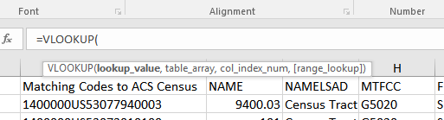
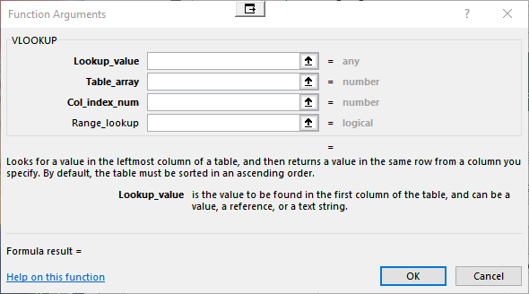
DATA REFERENCING
As you build these new Excel functions into your work, keep in mind that there are at least two ways to quickly see the fields that Excel requires to complete the action.
For example, when building a VLOOKUP statement:
In cell, type “=VL.”
Double click on the function name
that’s presented for syntax.
Alternatively, click fx in the menu ribbon, then select “function.”
Notes:
Instructor Notes:
As you demonstrate each of these functions, be sure to show the =function syntax support that Excel offers. Additionally, demonstrate clicking on the fx ribbon option to pop up the support window.

Slide 16
DATA REFERENCING IN EXCEL
GUIDED PRACTICE: BUSINESS SCENARIO

Slide 17
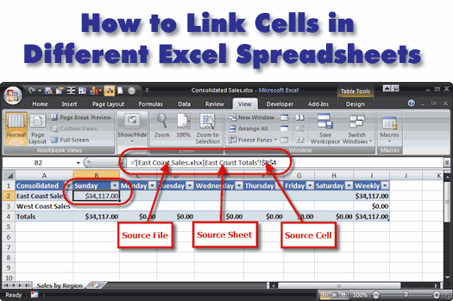
GUIDED PRACTICE: BUSINESS SCENARIO
We’ll combine data from another worksheet into our ACS data set.
We will also explore the concept of a “lookup table” and how to use one to categorize our quantitative data.
Notes:
Instructor Notes: In the work of an analyst, it is rare when you have all the data you need right in your dataset. Oftentimes, you will be given data in different formats, different spreadsheets, etc. One big step of data cleansing is simply getting the data into one dataset.
In the next unit, SQL, we will see how databases can be extremely helpful in this regard. If you don’t know how to use SQL, or if none of the data you are working with is in SQL, it can be easier to do this step in Excel.
Today, we will see how to combine data from another worksheet into our ACS dataset.
We will also learn the concept of a “lookup table” and how to use one to categorize our quantitative data.

Slide 18
DATA REFERENCING IN EXCEL
DEMO: VLOOKUP

Slide 19
VLOOKUP SYNTAX
The syntax is:
=VLOOKUP(lookup_value, table_array, col_index_num, [range_lookup])
Lookup_value is the value that will be used to match data. This is usually an identifier (an ID of some kind). It must exist in both worksheets.
Table_array is the table from which you want to retrieve data.
Col_index_num is the number of the column from the left side of the table_array from which you want to retrieve data.

Slide 20
VLOOKUP SYNTAX
The syntax is:
=VLOOKUP(lookup_value, table_array, col_index_num, [range_lookup])
Range_lookup defines whether or not the lookup_value is an approximate match or an exact match of the value you are comparing it to in the left-most column of the table_array.
TRUE: Approximate match is needed.*
FALSE: An exact match is required.
Notes:
NOTE: * True is selected by default. This option is only useful for numeric tables, sorted in ascending order.

Slide 21
SAMPLE DATA SET
Open the “demo1_accounts” worksheet from the “L3_demo_worksheets.xlsx” workbook.
Then open the “demo1_emails” worksheet.
In order to combine these two lists — where we’ll create a fourth column in “demo1_accounts” with email addresses — we can use VLOOKUP.
VLOOKUP will “look up” one value in another table and return another column in that row.
Notes:
“demo1_accounts” worksheet: This contains account names and numbers from a small company.
“demo1_emails” worksheet: this contains email accounts with account numbers, but no names.

Slide 22
VLOOKUP SYNTAX
In cell D2 of “demo1_accounts”, enter: =VLOOKUP(C2,demo1_emails!A:B,2,FALSE)
The email address should populate cell D2.
Double click the bottom-right corner of the cell — or click and drag — to replicate this function down the entire column.
Implement a “Named Range” to simplify what’s required.

Slide 23
VLOOKUP
Often, it’s helpful to create categorical values from numeric values. For example, a test that is scored 0–100 could be classified as A, B, C, D, or F, depending on the score.
Let’s classify our census tracts as either low, medium, or high.

Slide 24
VLOOKUP
What are some ways to create classification groups? One option is to break them down into percentiles, using the 33rd, 66th, and 99th percentiles.
A percentile is generally used to define which value has x percent less than the value in question. For example: If 13 is the 50th percentile, half of the numbers in the range are less than 13.
Notes:
Let’s break our data up into three equal-sized groups.

Slide 25
DATA REFERENCING IN EXCEL
GUIDED PRACTICE: USE VLOOKUP TO COMBINE DATA ACROSS WORKSHEETS

Slide 26
GUIDED PRACTICE
Earlier, we looked at the scatterplot comparing two columns in our data set:
Population estimate of our census tract.
Percent of people who commute with public transit.
There was no obvious relationship. This makes sense, as population and population density are not the same.
While we expect people in urban areas to use public transit more often, the number of people in a census tract is not necessarily a function of density.
Notes:
The business case here is want to better understand

Slide 27
GUIDED PRACTICE
Let’s look at the scatterplot between census tract density and public transit usage. Currently, we don’t have density data in our data set.
Follow these steps to create this scatterplot:
Open “census_tract_areas_WA.xlsx”
Here we have a few variables; the one of interest is area_sqkm (M).
It would be error prone and time consuming to copy and paste this data into our spreadsheet.
Source for Census tract densities: https://www.census.gov/geo/maps-data/data/tiger-line.html

Slide 28
PREPARE TO VLOOKUP
Before we can combine these data sources, we need to ensure that they have a column/identifier in common.
Take a look at column A in our original data set and column D in the new data set. Column A in the cleaned ACS data from last class is equivalent to column D in the new data set — but each value has “1400000US” on its front.
In “census_tract_areas_WA.xlsx,” create a new column: E, and enter this formula into cell E2: ="1400000US"&D2.
Expand it to all rows.
Check column data type for appropriate designation (general/text).
Expand it to all rows.
Notes:
Instructor Notes: Need to change the column datatype from number to text (or general) to get the concatenation to work correctly. When adding the new column, the default is frequently showing up as number which won’t work.

Slide 29
VLOOKUP
In our original worksheet, “2014_acs_select”, go to column AJ.
Name this “area_sqkm” by typing this in cell AJ1.
In cell AJ2, enter: =VLOOKUP(A2,census_tract_areas_WA!E:N,10,FALSE)
Expand this formula to all rows by double clicking the bottom-right corner of the cell.
Now we have the tract area in our data set!

Slide 30
CALCULATE THE DENSITY
In cell AK1, type “density.”
In cell AK2, enter the formula “=E2/AJ2” and expand.
Create a scatterplot between % public transit vs. your new density variable.
Do we see any interesting patterns now?
Let’s complete one more VLOOKUP. At the moment, our only identifier for each tract is the ID number.
What county are these tracts in?
Notes:
For Edit Data within scatterplot -- to match solution, AK must be X values:
series name: ='2014_acs_select'!$Q$2:$Q$1446
AK for X values ='2014_acs_select'!$AK$2:$AK$1446
Q for Y values ='2014_acs_select'!$Q$2:$Q$1446

Slide 31
USE VLOOKUP FOR COUNTY NAMES
Open “census_tract_county_names_WA.xlsx”. This file also includes the IDs, so we can use them as our common identifier to match the county names with the census tracts in our data set.
In our data set, label a new column “County”.

Slide 32
USE VLOOKUP FOR COUNTY NAMES
In the second row, enter our formula for VLOOKUP: =VLOOKUP(A2,[census_tract_county_names_WA.xlsx]ACS_14_5YR_B01002_with_ann!$A:$B,2,FALSE)
When selecting the table_array, it’s easy to use the cell selector (the mouse icon that’s a white “+”) to select the columns of our table_array. This is especially useful when crossing over to another file, as we’re doing here.
2. Copy the contents down by double clicking the square in the bottom-right corner. We’ve now successfully used VLOOKUP with two examples.

Slide 33
DATA REFERENCING IN EXCEL
GUIDED PRACTICE: USE VLOOKUP TO CREATE CATEGORICAL VARIABLES

Slide 34
VLOOKUP
Create a new worksheet called Density Lookup.
In cells A1, A2, and A3, enter values 0, 350, and 1420.
In cells B1, B2, and B3, enter values low, medium, and high.
Execution notes:
The lookup values must always be located on the left side of the data used for a table array when using VLOOKUP.
In this case, we select the TRUE parameter for the range_lookup value, causing the lookup function to compare the ascending range boundaries and return the category designation in the second column.
Notes:
The lookup will go from the value on the row up to the next entry (or infinity). In other words, they are left-bound.

Slide 35
VLOOKUP
On worksheet “2014_acs_select”, type “Density Group” in cell AL1.
In AL2, complete the lookup: =VLOOKUP(AK2,'Density Lookup'!A:B,2,TRUE)
Expand to all rows.
The densities have now been classified using our lookup table.
If we ever want to change our definition of the three classifications, all we have to do is modify the lookup table on the “Density Lookup” table tab, and the values will change accordingly!

Slide 36
DATA REFERENCING IN EXCEL
DEMO: VLOOKUP/HLOOKUP

Slide 37
HLOOKUP
HLOOKUP is very closely related to VLOOKUP, but instead of providing the column number, you provide the row number.
Looking at worksheet “demo2_hlookup” in “L3_demo_worksheets.xlsx”, consider the top table of grades for different students. In this case, the students are columns instead of rows.
Source: https://goo.gl/3cr1uY

Slide 38
HLOOKUP
Suppose we needed to fill out the second table using only formulas?
We would use an HLOOKUP, as we need to do the lookup across row A, instead of down a column.
Pro Tip: In the real world, HLOOKUP is used much less frequently. However, it is a method that can be used whenever your variables are each contained in a row and your observations are organized across a column.
Source: https://goo.gl/3cr1uY

Slide 39
HLOOKUP SYNTAX
Complete the following steps:
In cell B8, enter: =HLOOKUP($A8,$B:$L,2,FALSE)
We’re looking up the name, so $A8 is our lookup_value.
The table_array is the table of grades.
The row_index_number is how far down we need to go.
The range_lookup is the same here as in as VLOOKUP
Does our match need to be FALSE (exact match) or TRUE (range)?
Copy the formula down two cells by dragging the bottom-right corner.

Slide 40
CREATE OTHER HLOOKUPS
In cell C8, enter: =HLOOKUP($A8,$B:$L,2,FALSE)
Copy the formula down two cells.
In cell D8, enter: =HLOOKUP($A8,$B:$L,3,FALSE)
Copy the formula down two cells.

Slide 41
VLOOKUP & HLOOKUP: SYNTAX SUMMARY
Function arguments:
=VLOOKUP(lookup_value, table_array, col_index_num, [range_lookup])
=HLOOKUP(lookup_value, table_array, col_index_num, [range_lookup])
Value: The value to look for in the first column of a table.
Table: The table from which to retrieve a value.
col_index: The column (row) in a table from which to retrieve a value.
range_lookup: [optional]
TRUE = Approximate match. (Default)
FALSE = Exact match.

Slide 42
INTRODUCTION TO INDEX AND MATCH
MATCH returns the position of an item in an array that matches a value.
Syntax: MATCH(Lookup_value, Lookup_array, Match_type)
Lookup_value: Value or cell reference.
Lookup_arrange: Named range or specified cells.
Match_type: “0”: Exactly equal to lookup_value.
“-1”: Smallest value > or = lookup_value.*
“1”: Largest value < or = lookup_value.*
Example: I want to find the first occurrence of the words “Order Error” in the column containing order completion status.
Notes:
NOTE: *Lookup_arrange must be ordered correctly for -1 or 1 to function correctly.

Slide 43
DATA REFERENCING IN EXCEL
INTRODUCTION: INDEX AND MATCH
Demo

Slide 44
INTRODUCTION TO INDEX AND MATCH
VLOOKUP (and HLOOKUP) are great for “looking up” data, but they do have two significant limitations:
They are unidirectional, meaning they must work with indexes fixed to the left side (VLOOKUP) or top (HLOOKUP) of the work area.
Because the VLOOKUP references a col_index, it’s unable to dynamically update whenever you insert a column or columns in the table_array.
For additional flexibility and features, we’ll need to use INDEX/MATCH.
Notes:
NOTES:
Hard coded formulas can be problematic – Vlookup/Hlookup include a specific reference to a column (or row) number, which isn't dynamically indexing or responding to modifications in a hard coded table.
Named ranges is one way to increase flexibility here, however, locked values or hard coded values are very easy to break.

Slide 45
INTRODUCTION TO INDEX AND MATCH
INDEX/MATCH
Faster than LOOKUPS.
More flexible.
INDEX returns the value at the intersection of a row and column in a given range.
Syntax: =INDEX(Array, Row_num, Column_num).
Example: I want to know name of the customer in the fifth row of the “customer_name” column of my Sales table.

Slide 46
INTRODUCTION TO INDEX AND MATCH
These functions are powerful when combined. An INDEX/MATCH lookup allows you to specify lookup column and return the value column independently.
Syntax (Combined):
=INDEX(Return_value_range, MATCH(Lookup_value,Lookup_value_range, Match_type))
The search is not case sensitive.
If looking up text, you may use wildcards to search for a partial string.
An unsuccessful match will return #N/A.
Example: I want to return the name of the customer whose order completion status is “Order Error.”
Notes:
if text, may use wildcards = doing a search for a partial string

Slide 47
INDEX/MATCH EXAMPLE
Open “L3_demo_worksheets.xlsx” and go to the “demo3_index” worksheet.
In cell D2, type: =INDEX(A:A, 4)
In cell E2, type: =MATCH(“Coats”, A:A, 0)
For now, we’ll always use a “0” as the third argument. The “0”parameter requires an exact match. In the next section, we’ll see how to use an inexact match.
Source: https://goo.gl/susW9

Slide 48
INDEX/MATCH EXAMPLE
In cell H2, we will now combine INDEX and MATCH into a nested formula: =INDEX(A:A,MATCH(G2,B:B,0))
Copy it down to H3.
The inner MATCH looks up the “Product ID” of interest in the B:B column, returning the matching row number.
The row number from the MATCH above is then used in the INDEX to look up and return a value in column A:A.
Notes:
Instructor Talking Points:
Not only can we insert a column between A and B and not break our lookup_table (try it)
We also looked up a value on the left of the matched value.
That’s another thing we can’t do with VLOOKUP!

Slide 49
DATA REFERENCING IN EXCEL
GUIDED PRACTICE:
REVISING OUR VLOOKUPS

Slide 50
REVISE VLOOKUPS WITH INDEX/MATCH
Let’s recreate our VLOOKUPs from earlier using INDEX/MATCH. In a new column, let’s use INDEX/MATCH to look up the area of the census tracts again:
In row 2 of the new column, type: =INDEX(census_tract_areas_WA!N:N,MATCH ('2014_acs_select'!A2,census_tract_areas_WA!E:E,0))
Copy this down to all rows.
To check equality with our VLOOKUP by entering “=AN2=AJ2” in the next column (adapt as necessary if columns differ).
Copy down and ensure all values are TRUE.

Slide 51
REVISE VLOOKUPS WITH INDEX/MATCH
In a new column, let’s redo the density classification.
In row 2 of the new column, enter: =INDEX('Density Lookup'!B:B, MATCH('2014_acs_select'!AK2,'Density Lookup'!A:A,1))
Copy it down to all rows.
To check equality with our VLOOKUP, enter “=AP2=AL2” in the next column (adapt as necessary if columns differ).
Copy down and ensure all values are TRUE.
Notes:
Instructor Talking Point:
For step 1, notice we’re using a “1” as the third argument of MATCH.
This is the inexact match that is equivalent to the TRUE fourth argument of VLOOKUP we earlier used for the density classification.

Slide 52
DATA REFERENCING IN EXCEL
INDEPENDENT PRACTICE

Slide 53

ACTIVITY: PRACTICE VLOOKUP AND INDEX/MATCH
DIRECTIONS
EXERCISE
Open “L3_independent_activity.xlsx.”
Based on your experience, choose to complete either the BASE or STRETCH tab (25 min).
You may work with a partner, checking in with each other after answering each question.
DELIVERABLE
Complete BASE or STRETCH tab in “L3_independent_activity.xlsx.”

Slide 54
DATA REFERENCING IN EXCEL
CONCLUSION

Slide 55
CONCLUSION
In this lesson, we:
Reviewed data cleaning techniques and strategies.
Introduced NULLs with four options for preparation.
Learned how to use named ranges.
Demonstrated and applied two valuable data referencing techniques in Excel:
VLOOKUP and HLOOKUP
INDEX and MATCH
In our next lessons, we’ll continue on with more advanced Excel topics:
aggregate functions, PivotTables, and conditional formatting!

Slide 56
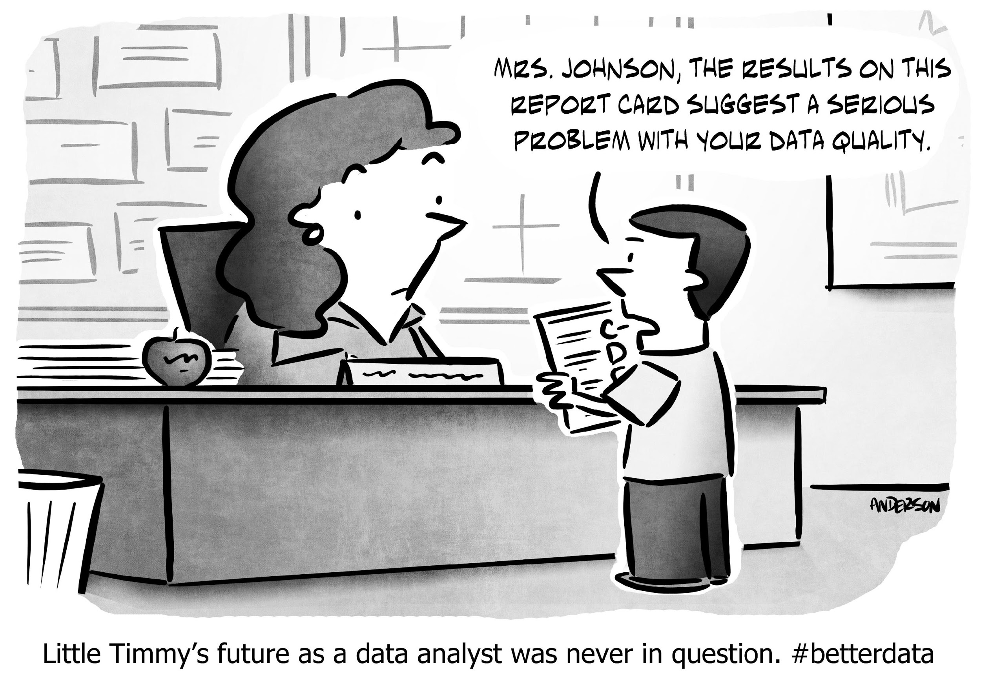
DATA REFERENCING IN EXCEL
Q&A

Slide 57
DATA REFERENCING IN EXCEL
RESOURCES

Slide 58
RESOURCES
DATA REFERENCING IN EXCEL
Excel Keyboard Shortcuts: https://goo.gl/EhClMw
http://www.randomwok.com/excel/how-to-use-index-match/
https://www.deskbright.com/excel/using-index-match-match/

Slide 59
DATA REFERENCING IN EXCEL
EXIT TICKET
DON’T FORGET TO FILL OUT YOUR EXIT TICKET!

Slide 60
CITATIONS
DATA REFERENCING IN EXCEL
Census tract densities: https://www.census.gov/geo/maps-data/data/tiger-line.html
HLOOKUP example adapted from: http://www.exceltrick.com/formulas_macros/hlookup-in-excel-with-examples/
INDEX/MATCH example adapted from: http://www.randomwok.com/excel/how-to-use-index-match/

